Slide 1
TECHNIQUES IN PHOTOGRAPHY

Slide 2
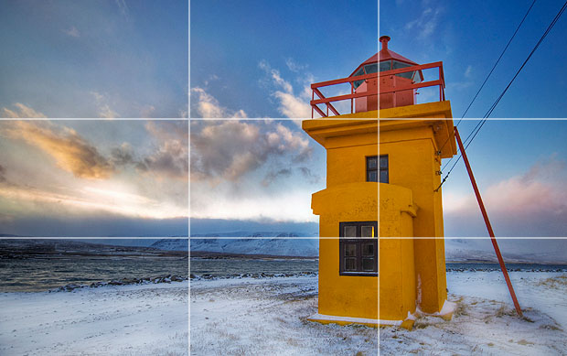
RULE OF THIRDS

Slide 3
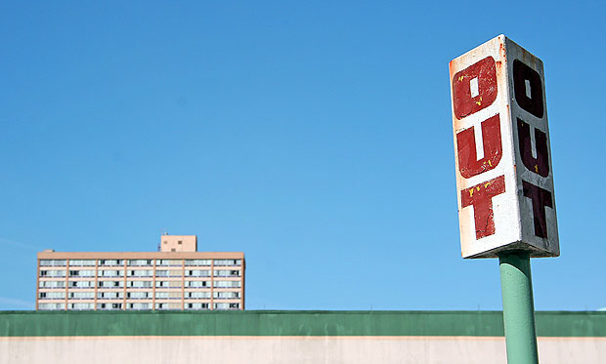
BALANCED ELEMENTS

Slide 4
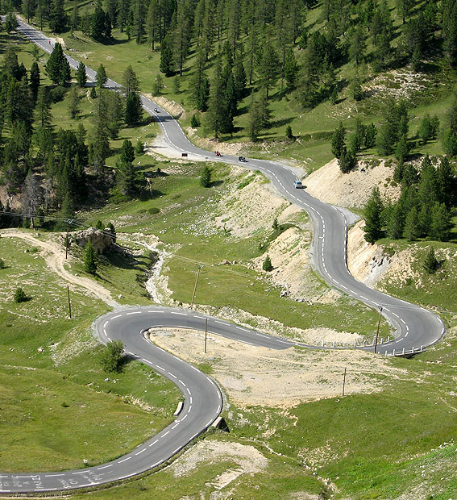
LEADING LINES

Slide 5
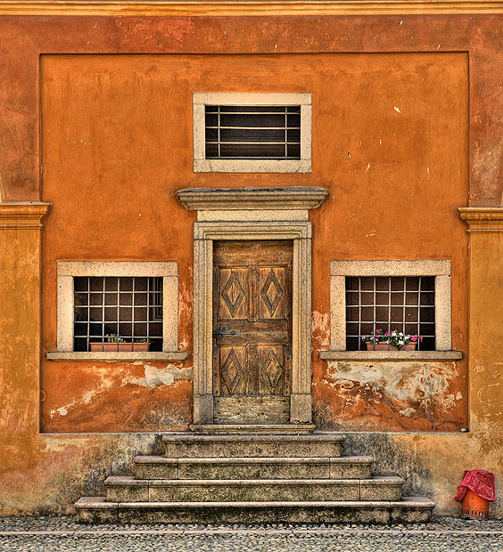
SYMMETRY AND PATTERN

Slide 6
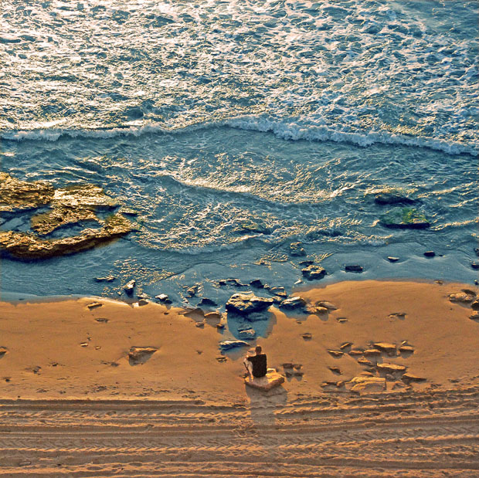
VIEWPOINT

Slide 7
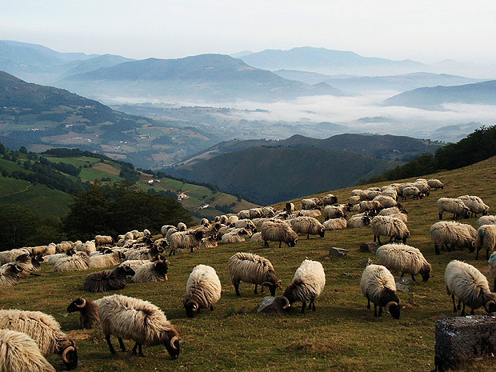
DEPTH

Slide 8
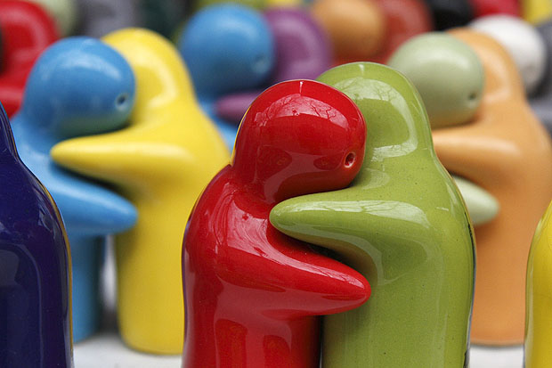
CROPPING

Slide 9
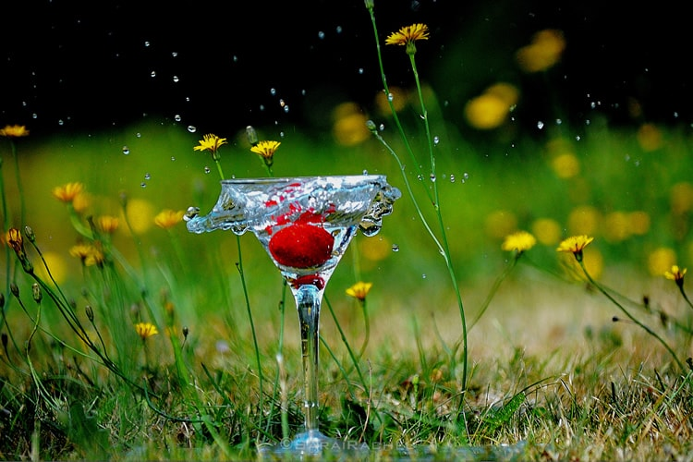
HI-SPEED PHOTOGRAPHY

Slide 10
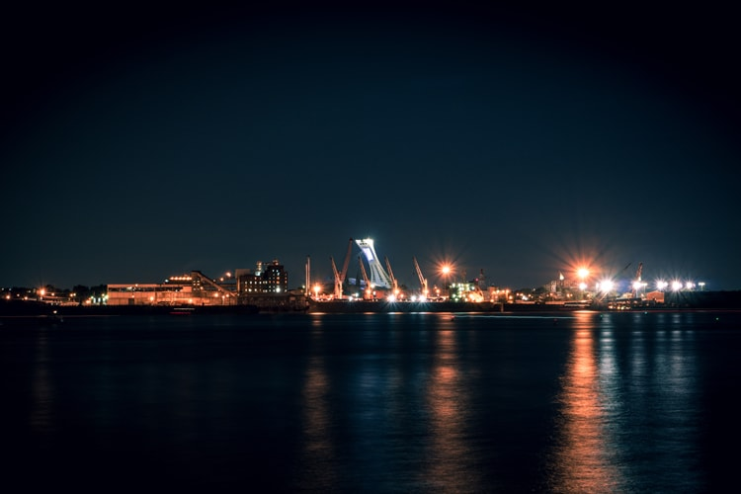
NIGHT PHOTOGRAPHY

Slide 11
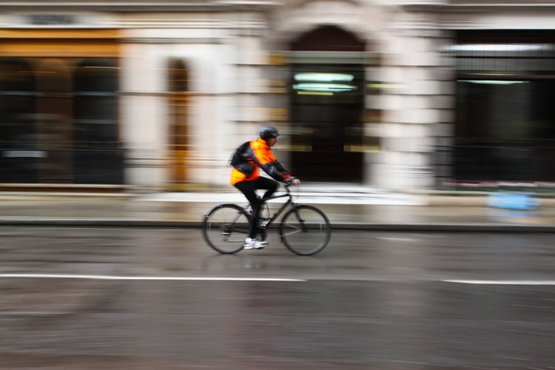
MOTION BLUR

Slide 12
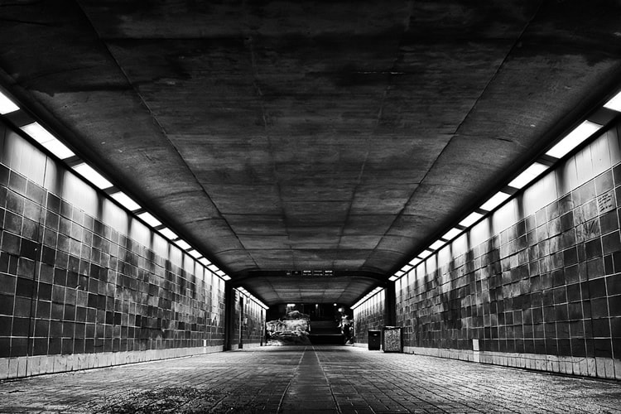
BLACK-AND-WHITE PHOTOGRAPHY

Slide 13
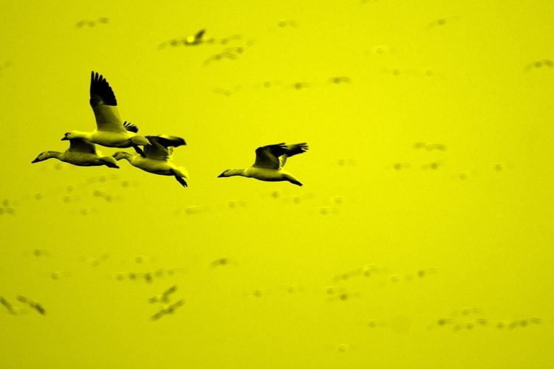
MONOCHROMATIC PHOTOGRAPHY

Slide 14
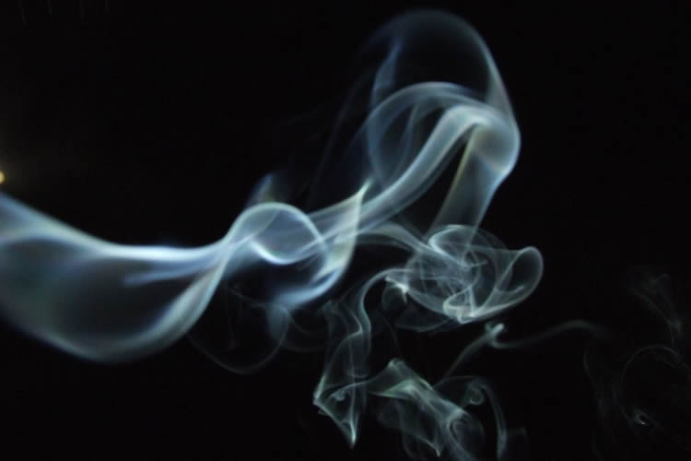
SMOKE ART PHOTOGRAPHY

Slide 15
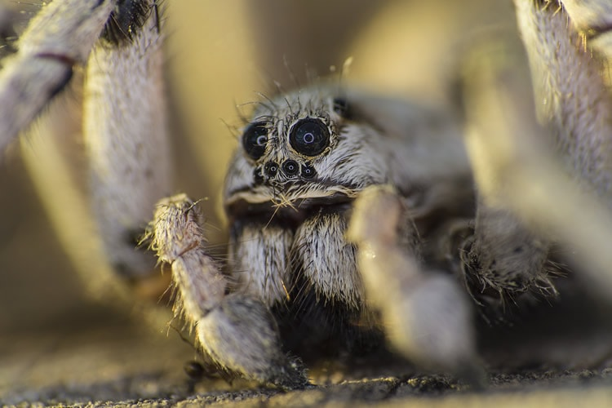
MACRO PHOTOGRAPHY

Slide 16
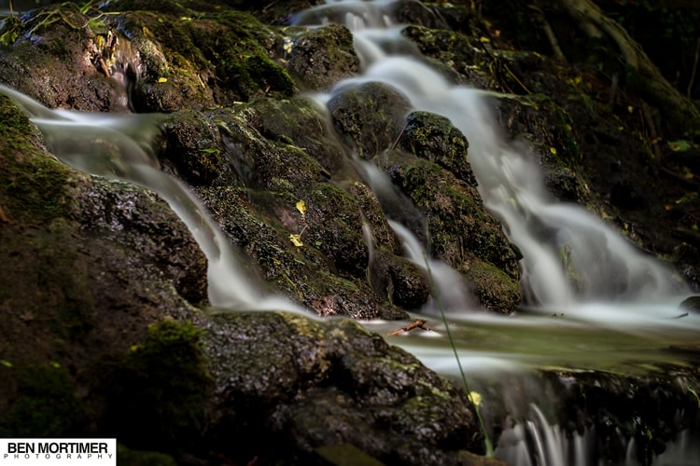
LONG EXPOSURE PHOTOGRAPHY

Slide 17
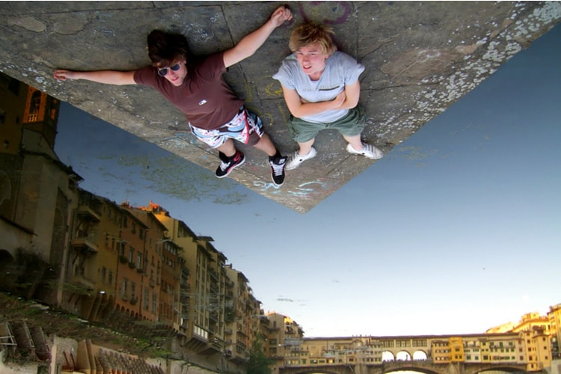
FORCED PERSEPCTIVE PHOTOGRAPHY

Slide 18
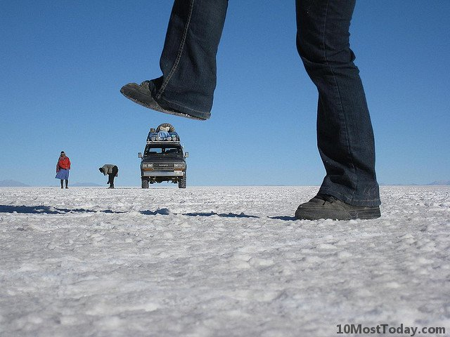

Slide 19
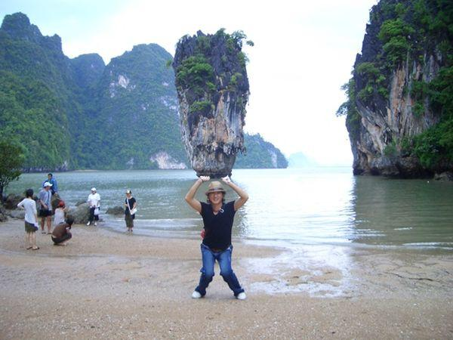

Slide 20

PANORAMIC PHOTOGRAPHY

Slide 21
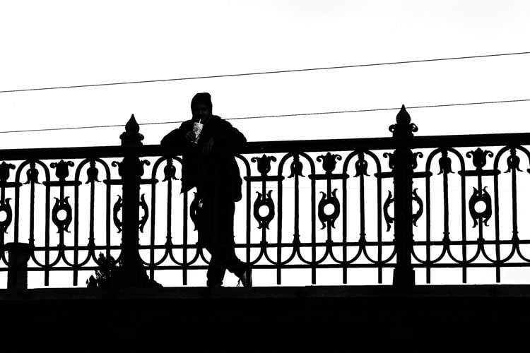
SILHOUTTES

Slide 22
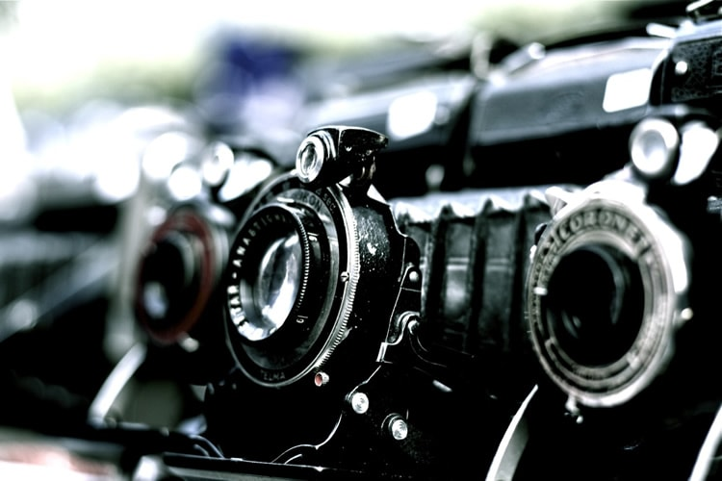
VINTAGE PHOTOGRAPHY

Slide 23
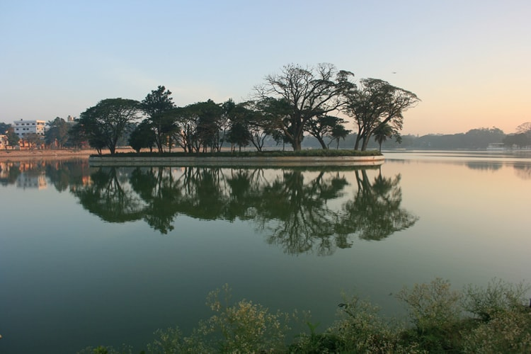
REFLECTION AND MIRROR PHOTOGRAPHY

Slide 24
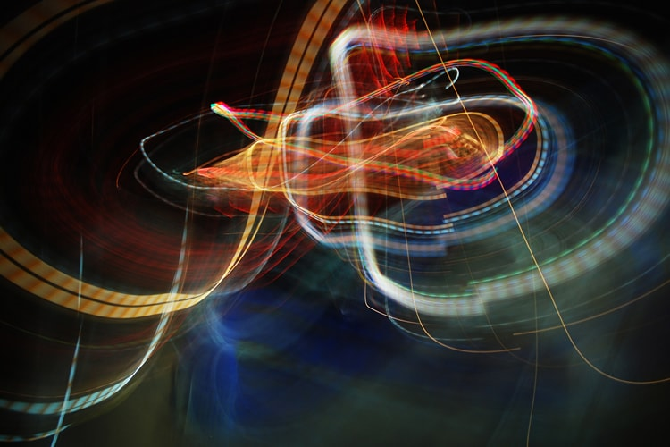
KINETIC PHOTOGRAPHY

Slide 25
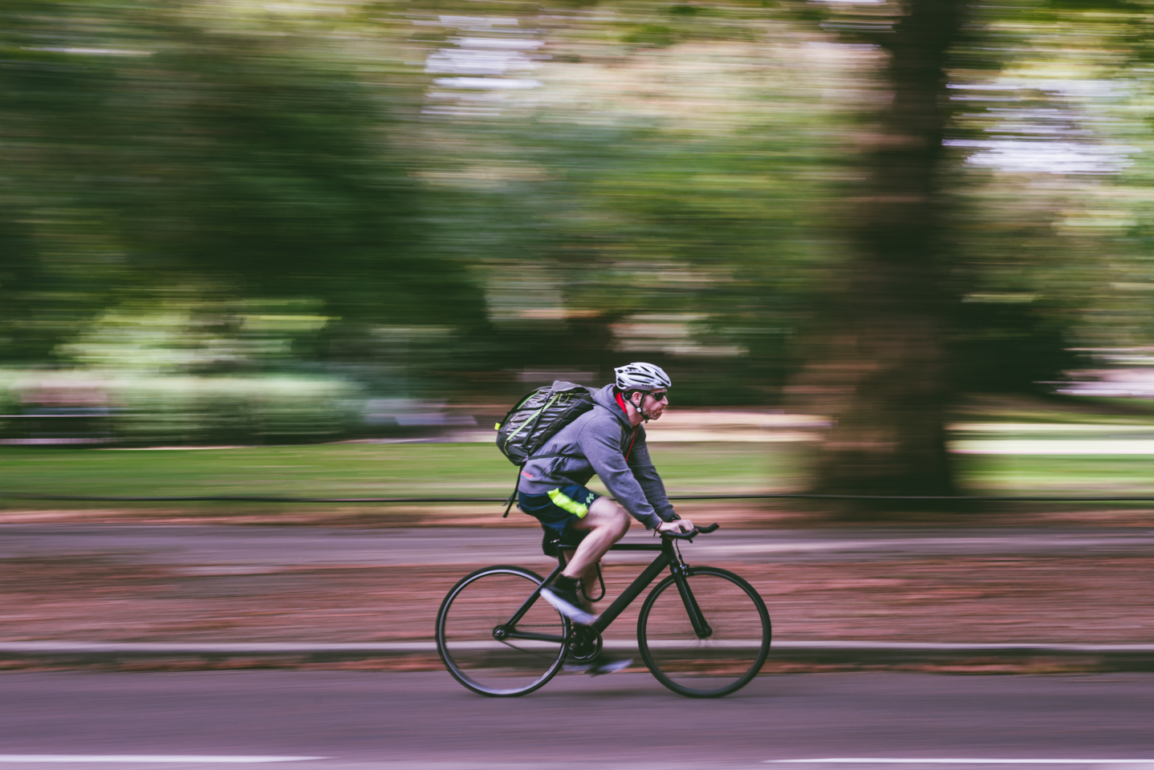
PANNING

Slide 26
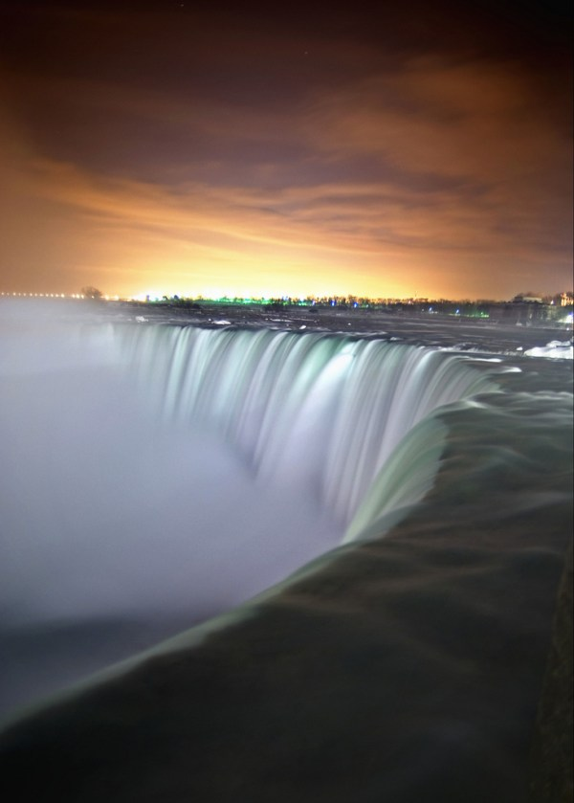
LONG EXPOSURE

Slide 27
HOW TO TAKE PHOTOS USING YOUR SMARTPHONE

Slide 28
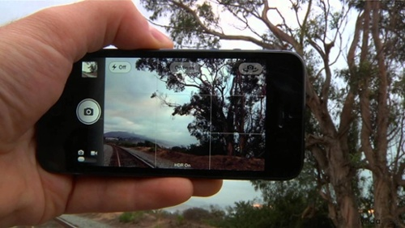
USE A GRIDLINE

Slide 29
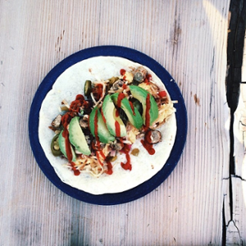
FOCUS ON ONE SUBJECT

Slide 30
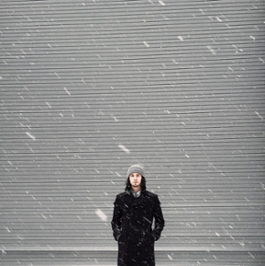
EMBRACE NEGATIVE SPACE

Slide 31

FIND DIFFERENT PERSPECTIVES

Slide 32
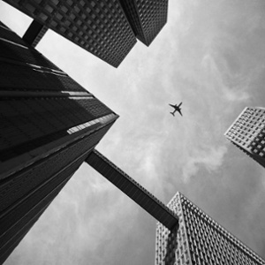

Slide 33
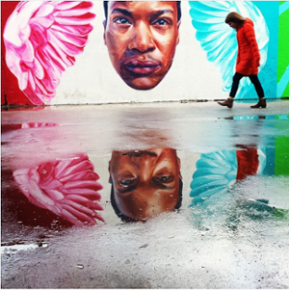
PLAY WITH REFLECTIONS

Slide 34
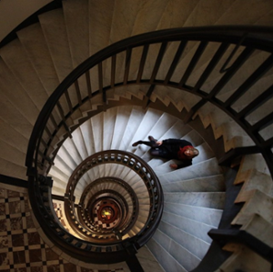
USE LEADING LINES

Slide 35
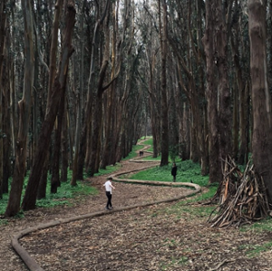

Slide 36

LOOK FOR SIMMETRY

Slide 37
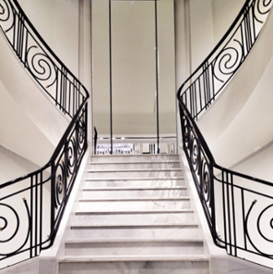

Slide 38
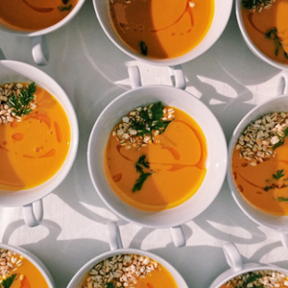
LOOK FOR REPETITIVE PATTERN

Slide 39
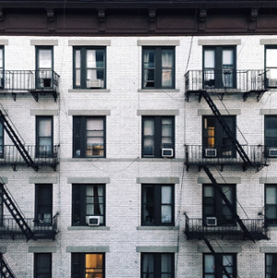

Slide 40
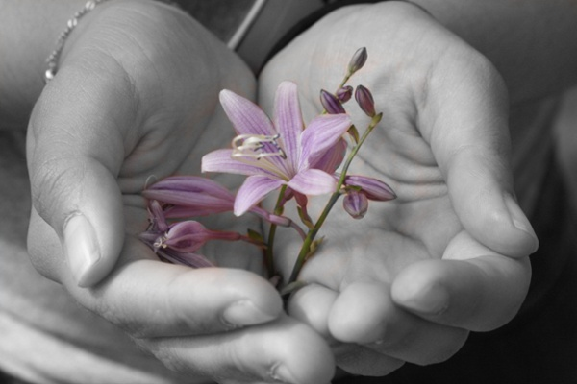
TRY COLOUR BLOCKING

Slide 41
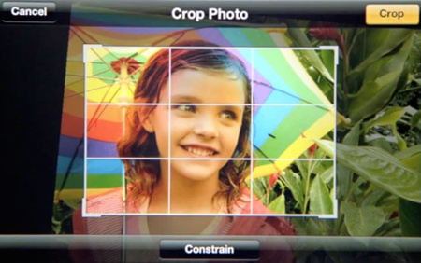
AVOID ZOOM IN

Slide 42
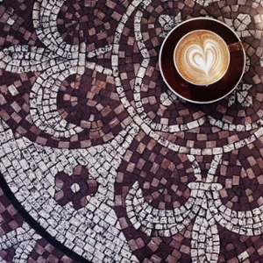
CAPTURE SMALL DETAILS

Slide 43
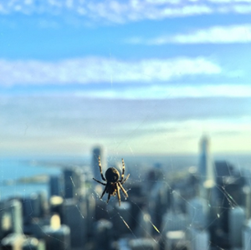

Slide 44
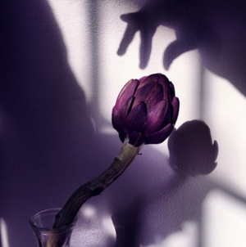
USE NATURAL LIGHTS

Slide 45
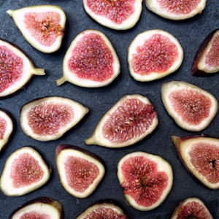
CREATE ABSTRACT

Slide 46

TAKE CANDIDS

Slide 47
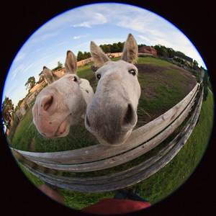
ATTACH EXTERNAL LENSE

Slide 48
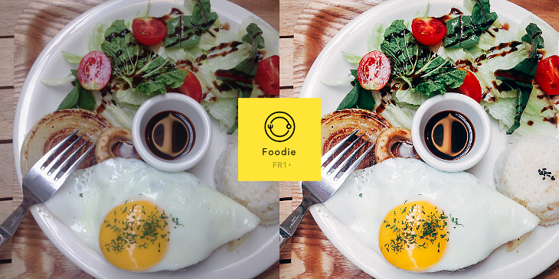
DON’T AFRAID TO EDIT

